Slide 1
Theory of Automata
Mathematical Preliminaries
Nasreen Akhtar

Slide 2
Mathematical reviews
Sets
Functions and Relations
Graphs and Trees
Proof Techniques
Theory of Automata

Slide 3
Sets (1)
A set is a collection of elements without any structure other than membership!
  Usually with some common properties
  Neither order nor repetition does matter
  E.g. S₁ = {a, b, c}, S₂ = {i | i is an integer ≥ 0}
A set can be finite or infinite
  The number of elements of a finite set is its size or cardinality, e.g. |S₁| = 3
Two special sets
  U – Universal set or Universe of discourse
  ∅ – Empty set, a set with no members
Theory of Automata

Slide 4
Sets (2)
is-a-member-of
  An element x is a member of a set S is written as x ∈ S
  An element Y is not a member of a set S is written as y ∉ S
Subset
  A is a subset of B, A ⊆ B, iff every member of A is also a member of B.
  A is a proper subset of B, A ⊂ B, iff A is a subset of B and not equal to B.
Theory of Automata

Slide 5
Sets (3)
Set operations
  Union: S₁ ∪ S₂ = {x | x ∈ S₁ or x ∈ S₂}
  Intersection: S₁ ∩ S₂ = {x | x ∈ S₁ and x ∈ S₂}
    If S₁ ∩ S₂ = ∅, they are said to be disjoint
  Difference: S₁ − S₂ = {x | x ∈ S₁ and x ∉ S₂}
  Complement (with respect to a universal set):‾S₁ = {x | x ∈ U but x ∉ S₁}
    ‾∅ = U
    ‾U = ∅
Theory of Automata

Slide 6
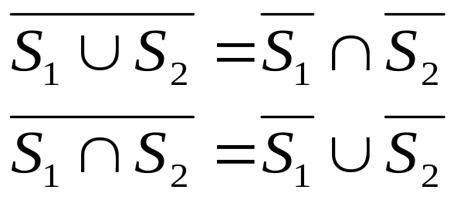
Sets (4)
De Morgan’s laws
A power set of S denoted 2^{S} is a set of all subsets of S
  |2^{S}| = 2^{|s|}
Theory of Automata

Slide 7
Sets (5)
A Cartesian product of two sets produce a set of ordered pairs
  S = S₁ × S₂ = {(x, y) | x ∈ S₁ and y ∈ S₂}
  |S₁ × S₂| = |S₁| × |S₂|
The subsets of S, S₁, S₂, …, S_{n} together, is called a partition of S if
  S₁, S₂, …, S_{n} are mutually disjoint
  S₁ ∪ S₂ ∪ … ∪ S_{n} = S
  None of S_{i} is ∅
Theory of Automata

Slide 8
Functions and Relations (1)
A function is a rule that assigns to elements of one set a unique element of another set
  f: S₁ → S₂
  The domain of f is a subset of S₁
  The range of f is a subset of S₂
  If the domain of f is actually S₁, f is called a total function; otherwise it is called a partial function
  E.g. f(n) = n³ + 4n² + 2n + 1
Theory of Automata
Notes:
Function has exactly one element in its range

Slide 9
Functions and Relations (2)
For f(n) and g(n) whose domain is a subset of positive integers, if there exists a positive constant c for all sufficiently large n, we have
  If f(n) ≤ cg(n), then f has order at most g; f(n) = O(g(n))
  If |f(n)| ≥ c|g(n)|, then f has order at least g; f(n) = Ω(g(n))
  If there exist constants c₁ and c₂ such that c₁|g(n)| ≤ |f(n)| ≤ c₂|g(n)|, then f and g have the same order of magnitude; f(n) = Θ(g(n))
Theory of Automata

Slide 10
Functions and Relations (3)
In a simple form, a relation can be represented as a set of ordered pairs!
Relations are more general than functions; each element in the domain may have several elements in the range associated with it
  E.g. older than, sibling
Again, a simple form of relation can be (and usually) defined based on the Cartesian product of a single set, i.e. a set with itself, e.g. a set of positive integers, a set of students in this class
Theory of Automata

Slide 11
Functions and Relations (4)
One special kind of relations is equivalence relation
When a pair (x, y) is in an equivalence relation, we write x ≡ y
A relation is an equivalence relations denoted by ≡, if it satisfies three conditions
  Reflexivity: x ≡ x for all x
  Symmetry: if x ≡ y, then y ≡ x
  Transitivity: if x ≡ y and y ≡ z, then x ≡ z
Is “older than” an equivalence relation?
Is “sibling” an equivalence relation?
For a given set S with an equivalence relation, the equivalence relation can be used to partition the set into equivalence classes
Theory of Automata

Slide 12
Functions and Relations (4)
Test
If x ≡ y
And x mod 3=y mod 3
Then test whether the following are equivalent or not
2 ≡ 5
12 ≡ 0
11 ≡ 1
0=36
Theory of Automata

Slide 13
Graphs and Trees (1)
An undirected graph or simply a graph is a set of points with lines connecting some of them
  The points are called nodes or vertices, V = {v₁, v₂, …, v_{n}}
  The lines are called edges, E = {e₁, e₂, …, e_{m}};
  G = (V, E)
A directed graph or digraph is a graph with directional arrowed edges
  each edge connects a pair of vertices from V, e_{i} = (v_{j}, v_{k}) is an edge from v_{j} to v_{k}
Theory of Automata

Slide 14
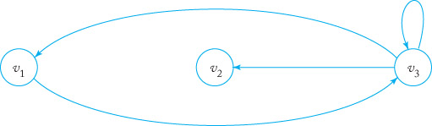
Graphs and Trees (2)
An example of a directed graph
Theory of Automata

Slide 15
Graphs and Trees (3)
A walk is a sequence of edges from one vertex to another
  The length of a walk is the total number of edges traversed
A path is a walk in which no edge is repeated
  A path is simple if no vertex is repeated
A walk with no repeated edges (a path) from v_{i} to itself is called a cycle with base v_{i}
A simple cycle is a cycle with no vertex repeated
An edge from a vertex to itself is called a loop
Theory of Automata

Slide 16
Graphs and Trees (3)
A tree is a digraph that has no cycles
  There is one distinct vertex called root
  There is exactly one path from the root to every other vertex
  Root has no incoming edges
  Vertices that have no outgoing edges are called leaves
  When there is an edge from v_{i} to v_{j}; v_{i} is a parent of v_{j} and v_{j} is a child of v_{i}
  The level of each vertex is the number of edges in the path from the root to itself
  The height of a tree is the largest level number of any vertex it has
  When an ordering is associated with nodes at each level, we have an ordered tree
Theory of Automata

Slide 17
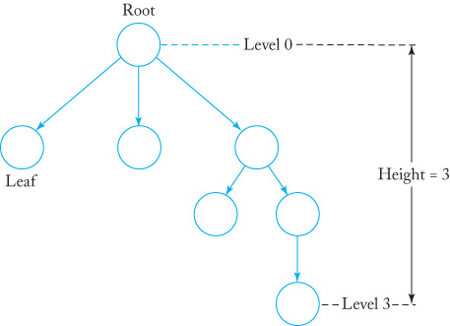
Graphs and Trees (4)
An example of a tree
Theory of Automata

Slide 18
Illustration of tree terminology
Leaves
L
L
L
Parent
Child
P
C
Level
2
0
1
Theory of Automata

Slide 19
Proof
A proof is a convincing logical argument that a statement is true!
Evidence plays no roles in a mathematical proof!
We need to provide a proof beyond any doubts!
A well-written proof is a sequence of statements where each is derived by simple reasoning from previous ones in the sequence
Theory of Automata

Slide 20
Proof techniques
Proof by induction
Proof by contradiction
Proof by construction
Theory of Automata

Slide 21
Proof by induction
It is an advance method used to show that all elements of an infinite set have a specified property
Each proof by induction consists of
  Basis: proves that P(1) [or P(b)] is true
  Inductive step: proves that for each i ≥ 1 [or i ≥ b], if P(i) is true, then so is P(i+1)
Once each part has been proven, it can be concluded that P(i) is true for each i
The assumption that P(i) is true in the inductive step is called induction hypothesis or inductive assumption
A stronger version of the hypothesis, i.e. P(j) is true for every j ≤ i, may sometimes be useful
Theory of Automata

Slide 22
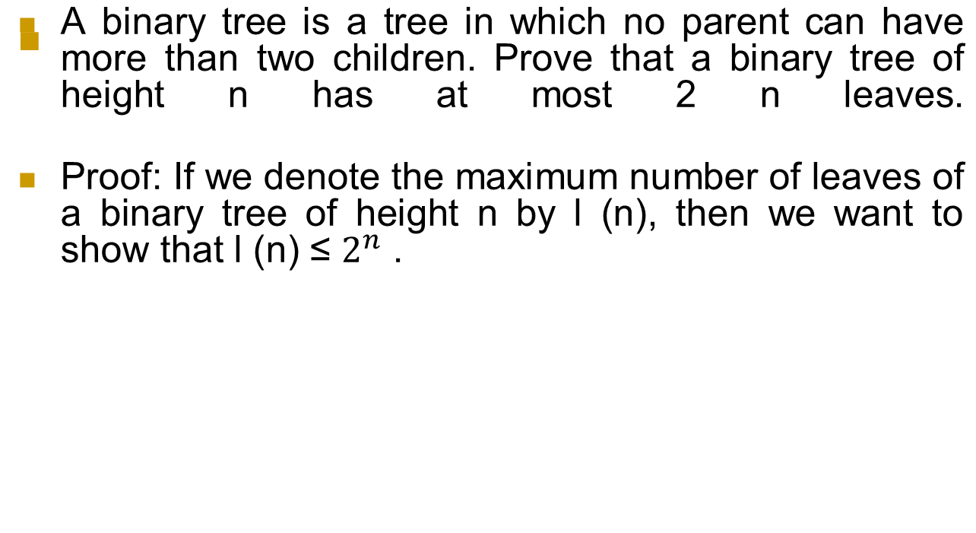
Proof by induction
Theory of Automata

Slide 23
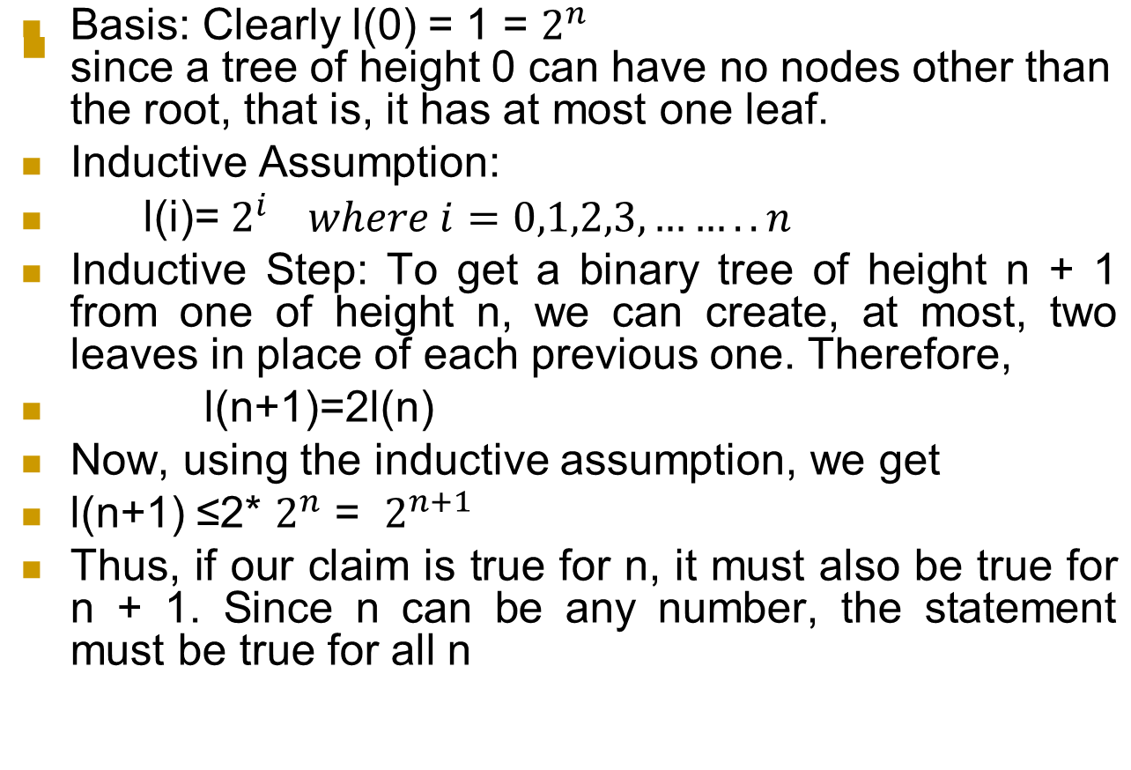
Proof by induction
Theory of Automata

Slide 24
Proof by contradiction
Assume that the statement/theorem (that we want to prove) P is false, then show that the assumption leads to an obviously false consequence called a contradiction!
Then, we have proven that our assumption is no good; hence the statement P is true!
E.g. If A is a subset of B and B is a subset of A then sets A and B are equal
Theory of Automata

Slide 25
Proof by construction
For those theorems/statements that state that a particular type of object exists, we may provide a proof by showing how to construct the said object!
E.g. De Morgan’s laws on sets A and B
Theory of Automata

Slide 26
Theorem
A theorem is a mathematical statement that has been proven true! – normally, a theorem is a statement of special interest
Statements that have been proven just for assisting in proving another statement are called “lemmas”
Statements that can be concluded easily from some theorem and its associated proof are called “corollaries”
Theory of Automata

Slide 27
Assignment 1
Solved Exercise from ( Q 20 to Q 46) formal languages and automata by jones & Bartlett
Deadline: Monday 26 August 2019
Theory of Automata

